Slide 1
Reproducible Clinical Data Analysis with R and RStudio
Session 1
Introduction
Notes:
Welcome to Reproducible Clinical Data Analysis with R and RStudio.

Slide 2
Warm up
Form groups of 2-3 people. Tell each other:
1. Who you are
2. What you’ve done with data in Microsoft Excel
3. What you’d like to be able to do with R/RStudio
Notes:
This is a highly interactive course, and you’ll be doing a lot of the exercises in groups. So I’d like to kick things off by having you form pairs or groups of 3, and tell each other who you are; what experience you have with MS Excel; and what you’d like to do with R/RStudio. If you don’t know yet, that’s fine! Also – make sure that there’s at least one laptop in each group.

Slide 3
Stephan
Notes:
My turn now – I’m Stephan. I’m from Germany originally, and came the the US for College. I got a combined MD and PhD degree at the University of Pennsylvania and trained in Clinical Pathology and Transfusion Medicine at the Massachusetts General Hospital, and for a little more than a year I’ve been an Asst Prof of Clinical Pathology and Lab Medicine at the Children’s Hospital of Philadelphia.
In my CP residency I got frustrated with the fact that even though there’s a lot of talk about introducing MDs, especially pathologists to data, there wasn’t any practical introduction to data analytics… so I spent my final year of residency creating this course for Path residents, fellows, and faculty, and it’s now in its #th iteration.

Slide 4


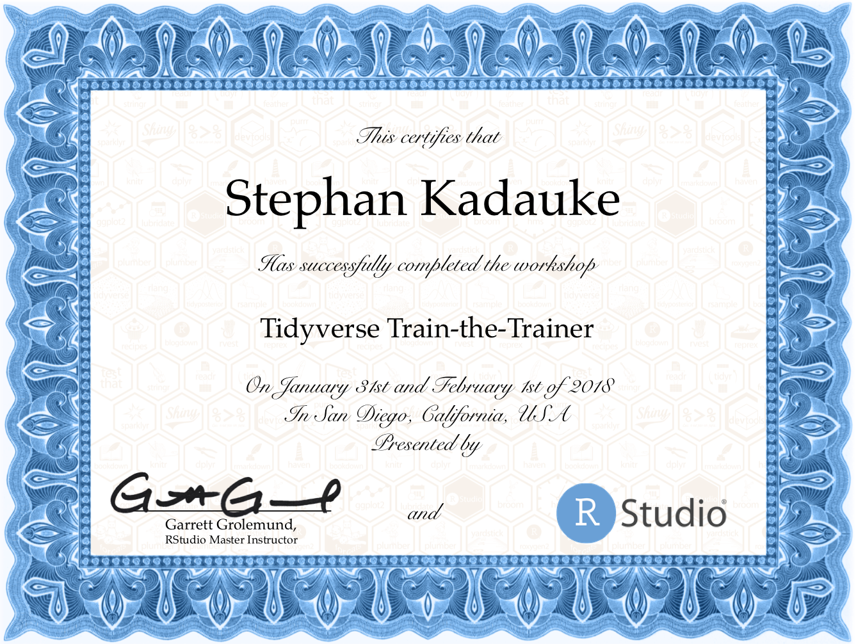
Notes:
I’ve been coding in R for 8+ years, and I’ve taught R at the MGH, Penn, and at these conferences. I was also a speaker at the rstudio conference where I talked about getting MDs to collaborate better with data analysts. CHOPR.

Slide 5
Course Structure
Notes:
Before we get into the material, I want to take a few minutes to explain the structure of this course.

Slide 6
Goals
1. Appreciate Reproducibility in Data Analysis
2. Learn a Practical Way to Analyze Clinical Data Reproducibly
Objectives
1. Define “Reproducibility” and Explain its Importance
2. Learn How to Use R/RStudio to Import Data from Files and Databases; Transform Data; and Visualize Data
3. Create a Reproducible Report Written in R Markdown
Notes:
Goals
1. Gain an appreciation for the importance of reproducibility in data analysis
2. Learn a practical approach to analyze clinical data in a reproducible fashion
Objectives
By the end of the course, you should:
1. Be able to Define “reproducibility” and explain its importance as it relates to data analysis
2. Gain confidence in your ability to use R/Rstudio to import data from files and databases; and transform and visualize data.
3. Create, with technical assistance from Dan, Amrom, and me, a reproducible report
Aside: too slow? Please help others.

Slide 7
Introduction | 8:30 – 10:00
Getting Data | 10:10 – 11:45
Lunch | 11:45 – 12:30
Exploring Data | 12:30 – 2:30
Reproducible Reports | 2:40 – 4:00
Notes:
I’ve designed this course so achieve these objectives in the most direct way possible.
The course consists of lectures and a course project, which I’ll describe in a minute.
In the first lecture I’ll be
The lectures follow the structure of a reproducible report – starting by getting the data, and then exploring and visualizing it.
Hackathons – probably weeks of 3/18, 3/25, 4/1
Course project – probably week of 4/8

Slide 8
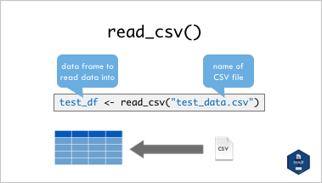
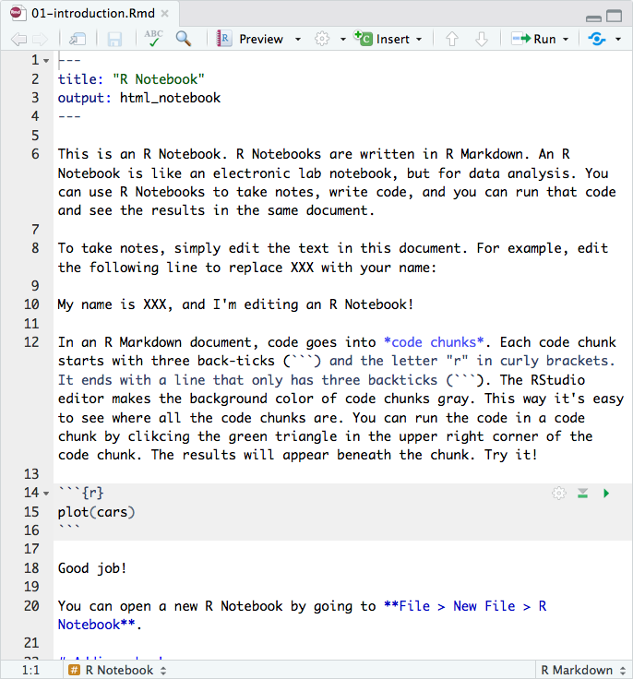
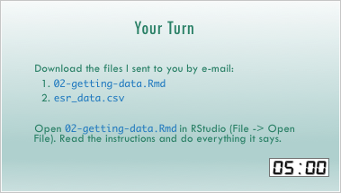
Workshop
Notes:
With only a few hours of lecture time, it isn’t possible to be comprehensive. After you’ve finished the course you might actually be surprised at how few R commands we covered. But this is by design. I assume that you guys have no prior experience programming. What I’m going to try to do is give you the basic mental models so you can appreciate what’s involved in writing a reproducible data analysis, and to become efficient at figuring out what you need to know and where to find the answers to tackle a specific problem you have. I’ll also point out where to look for additional details and further learning. A good way to think about this course is that it’s primer that sets you up to go out and learn R for your own work.
So in the lectures, I will present key concepts on slides. There will also be timed interactive exercises to help you consolidate the material just covered. In some of these exercises you’ll be working inside the RStudio editor so it’s important that you bring your laptop to each session.

Slide 9
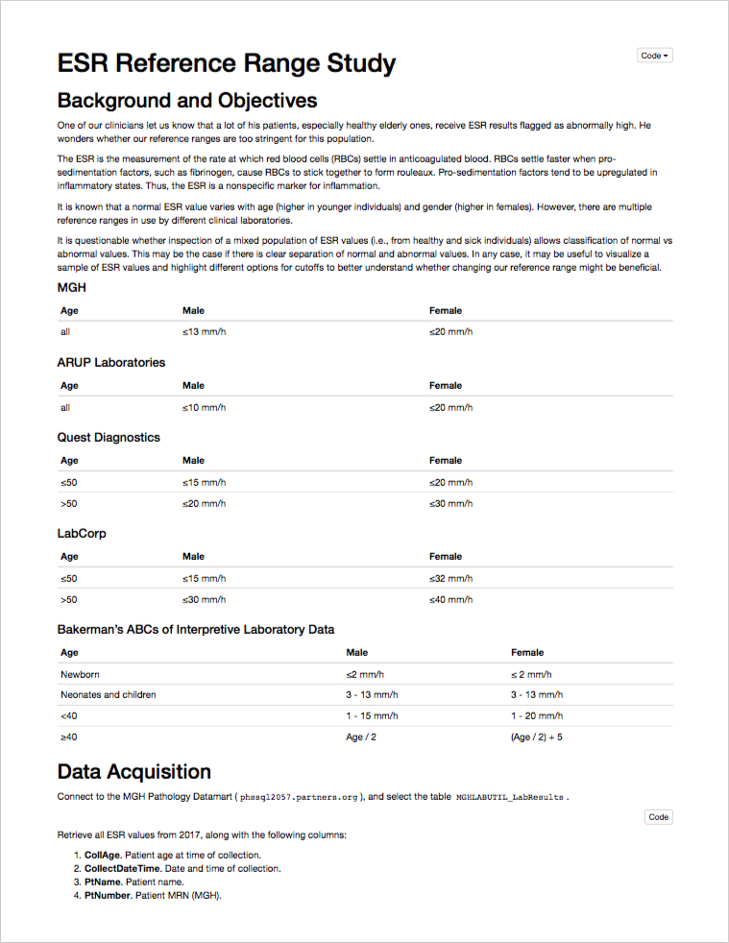
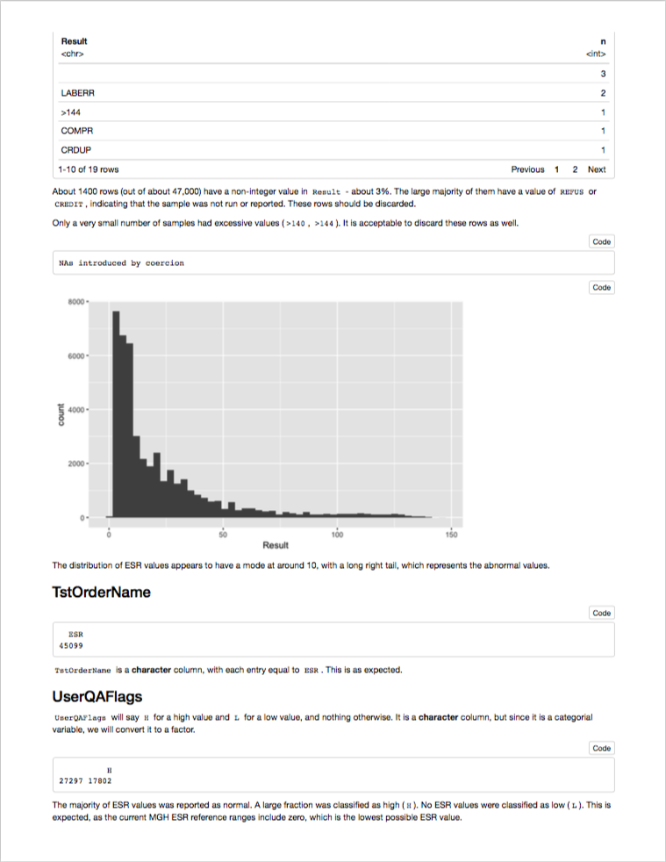
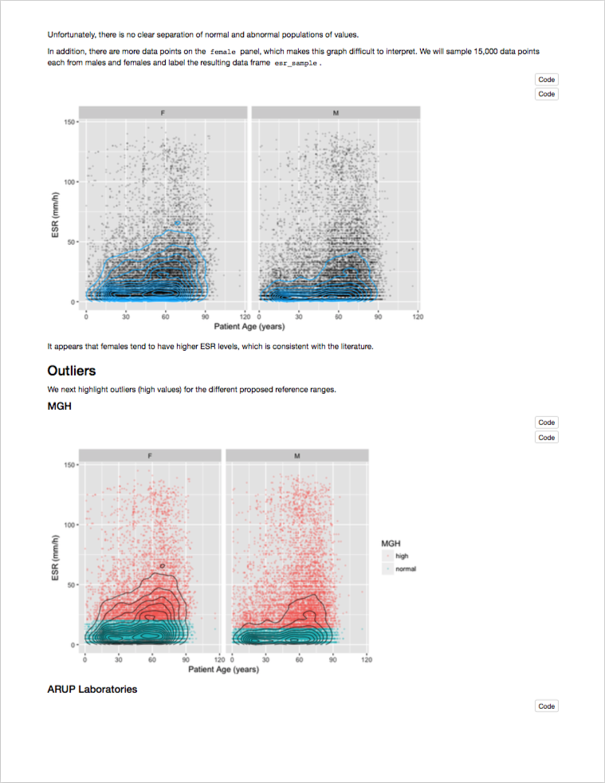
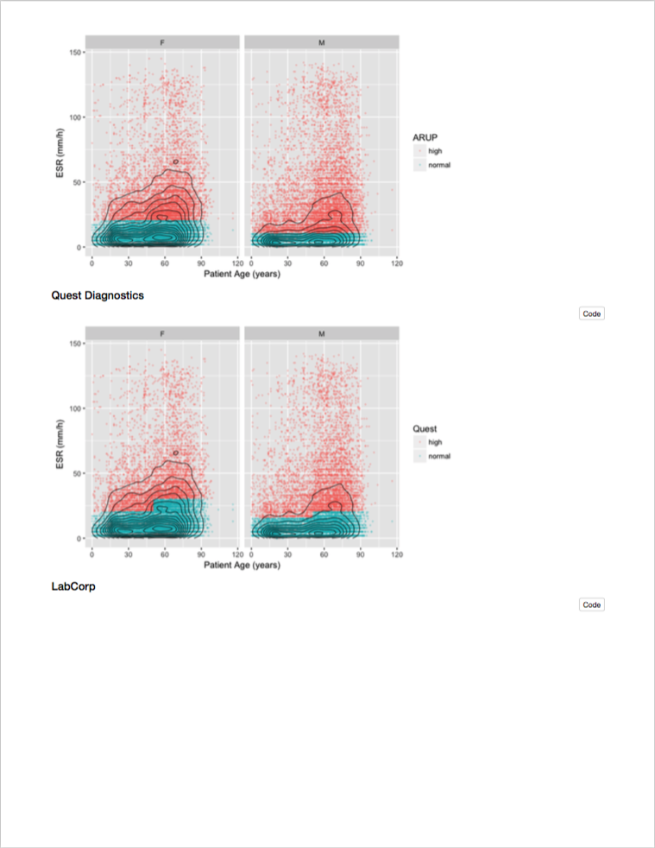
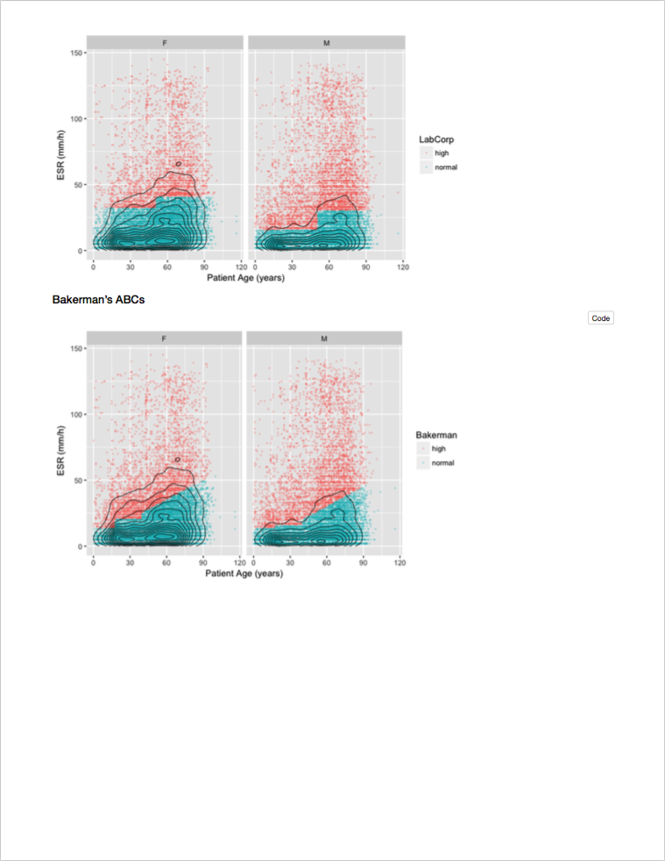
Course Project
Notes:
Together, these in-class activities should get you to a point where you can follow along a reproducible report that’s created in R. However, you won’t learn how to do your own reproducible analysis unless you actually do your own analysis. That’s the purpose of the course project.
Do you have to do a course project? No – this course and any part of it is completely voluntary. But you will get so much more out of this course if you do. I would go so far as to say that sitting through this workshop and then NOT doing a course project is kind of a waste of time. So I hope that all of you are going to do a course project.
Course projects will be presented in a separate session in about 4 weeks from now. We’ll schedule a time that works for everyone.
For the course project you will want to start with a question that broadly relates to an aspect of quality of care or clinical research. You will then write the code to load a relevant data set into R and create a graph or a statistical summary that addresses the question. Since all the computer code is inside the report, that automatically makes it reproducible. We’ll look at how this works in much more detail.
For example, here is a reproducible report that examines ESR results, taken straight out of CERNER. You can see that there’s a section that defines the question, a section that specifies the data source, and a section that explores the data and cleans it up, if necessary.
* Finally, there’s a section labeled “Visualization and Modeling” that attempts to answer the question, what’s the variability of ESR by age and gender, graphically.

Slide 10
Hackathons
Participants work 1:1 with experienced R users on the course project
Helps troubleshoot problems
Practice collaborating on analytics projects

Slide 11
Reproducibility

Slide 12
Replication vs Reproduction
Replication: other people collect new data
Scientific gold standard
Difficult and time-consuming
Reproduction: other people analyze the same data
Does not by itself validate the analysis …
Has been proposed as a minimal standard
Notes:
It’s probably a good idea to start by defining the closely related but distinct concepts of Replication and Reproduction.
Replication: other people collect new data and reach the same conclusions
This is the scientific gold standard but is also difficult and time-consuming.
Reproduction: other people analyze the same data and reach the same conclusions
Reproduction does *not* show by itself that the study is valid. There could still be problems with external validity of the conclusions, however, since it’s theoretically so much easier than going out there and doing an entirely new study, reproducibility has been proposed as a minimal standard to examine the scientific validity of the conclusions of a study.
And as the data analysis part of a study becomes more complex, reproducibility of the data analysis becomes more important.

Slide 13
The Duke Cancer Scandal
Chemo sensitivity from microarrays
Errors first, then misconduct
Clinical trials based on flawed models
Papers retracted, lawsuits settled
Notes:
The Duke cancer scandal, perpetrated by Anil Potti and Joseph Nevins, is a case study that has been extensively covered in scientific and lay press.
Potti and Nevins tried to use microarray gene expression data of tumor tissue to predict sensitivity to chemotherapeutic agents. That was a highly anticipated technology back in the mid-2000s, and their papers got published in high-profile journals including Nature Medicine, JAMA, and the NEJM.
Unfortunately, there were serious errors in the analysis pipeline and then the investigators tried to cover that up
Even more unfortunately, clinical trials were based on flawed models, and patients were allocated to the wrong treatment arms
In the end, 11 papers were retracted, and Duke settled 11+ lawsuits.
Although media coverage focused on misconduct, the root cause of patient harm here was that errors that were made during the analysis stage weren’t appreciated in time before clinical trials started. And the main reason these errors remained undetected for such a long time is that there wasn’t a record of the data analysis steps that would have allowed others to examine what the investigators had done.

Slide 14
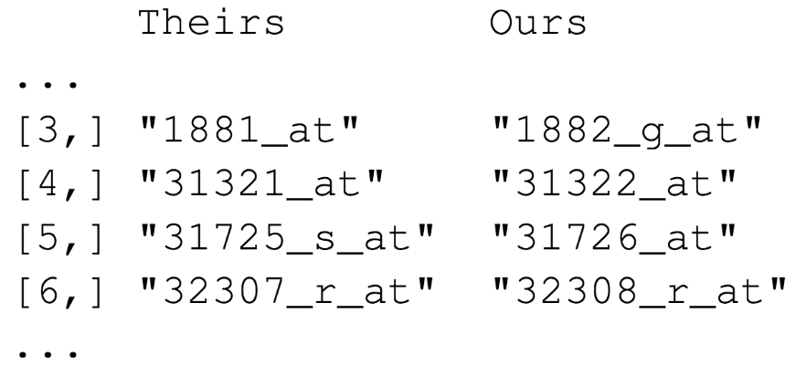

“Common errors are simple, Simple errors are common”
https://youtu.be/tN31vZj0LZY
Notes:
Keith Baggerly, a bioinformatician at MD Anderson, wanted to reproduce the results from one of the papers, be he consistently got different results.
After trying to resolve these inconsistencies with the authors of the paper, he started trying to figure out how the authors must have gotten to the wrong results. Here is an example:
These are a few of the hundreds of probe sets – each corresponds to a gene – that the Duke investigators reported to predict sensitivity to 5-FU.
Left (“Theirs”): probe sets as they were reported in the paper.
Right (“Ours”): the probe sets which Baggerly got when he re-did the clustering analysis to get to the list of significantly associated probe sets.
You might appreciate that there is an off-by-one indexing error (frameshift) – root cause: the program the Duke investigators used has a GUI that requires two inputs, first: a list of gene expression values, WITH header row; and second: a list probe sets, in the same order as the first list, but WITHOUT a header row. So when you use Excel and you cut and paste and include the header row this is what you get.
This is just one of many errors he discovered. All of the errors were simple, like label reversal, batch effects, and indexing errors. These errors are common and don’t necessarily indicate that the investigators who make them are incompetent. Peer review of a well-documented analysis actually makes these kinds of errors straightforward to find and fix. But without documentation, it’s very time consuming.

Slide 15
Point-and-Click Is Not Reproducible
Interactive tools do not record user actions
Manual documentation is error-prone
Manual analyses cannot be repeated on new data sets or shared with collaborators
Computer code can precisely document each step of the analysis
Notes:
One of the main lessons to take away from the Duke Scandal is that a critical barrier to reproducibility is the tendency of investigators to use graphical user interface “point-and-click” type software.
These interactive tools don’t record user actions.
Even if you try to manually document every action you take in MS Excel, it’s usually not complete enough for other others to retrace your steps without having to make a lot of assumptions.
Another important drawback of manual data analysis is its inefficiency. If you want to analyze a new or even slightly different set of data (and most of the time you do a complex analysis, you will!) you’ll have to start over and do everything again.

Slide 16
Why YOU Should Do Data Analysis Reproducibly
“Can we redo the analysis with this month’s data?”
“Why do the data in Table 1 not seem to agree with Figure 2?”
“Why did I decide to omit these six samples?”
Your closest collaborator is You from 6 months ago
(But you don’t answer e-mails)
Notes:
But reproducibility doesn’t only help others, which makes sense when you consider the following three statements and ask yourself if they sound familiar.
…
* …
(On a more serious note - if you’re analyzing clinical data and might reasonably change patient management based on your findings, that makes it so much more important that you take steps to assure your analysis is free of errors.)

Slide 17
Your Turn #1
Spend one minute writing down as many reasons as you can think of for why you might want your own data analyses to be reproducible.
Then form groups of 2-3 people to compare your lists with each others’.
Notes:
After time is up, ask people to share.

Slide 18
The Tools We’ll Use
Notes:
In this section, I’ll discuss some of the decisions we’ve made around the tools we will use in this course.
One basic principle we try to adhere to is that although there are many ways you can do something in R, we will demonstrate only ONE way, the way we believe to be most powerful, intuitive, and suited for the objectives of the course.

Slide 19
Why R?
Concise human-readable code for data transformation and graphics
Widely used and wildly popular
Reproducible reporting
Notes:
“R” Does Not Stand for “Reproducible”… But It Might As Well
R code is concise, and in the style that we’ll be using in this course, also often quite human-readable.
R is free, and so are thousands of R packages are free. They work on Windows computers, Macs, and inside a web browser. It’s widely used in academia and industry. If there’s a fancy or new statistical method you want to use, or one that’s only used in a specific field (like method comparison or RNA-seq analysis) there’s probably one or more well-documented R packages for it.
R Markdown, which we’ll talk about more later, makes reproducible report writing easy.

Slide 20
What is RStudio?
Free and open-source state-of-the-art integrated development environment
Tightly integrated with R Markdown for reproducible reporting
Built-in support for modern machine learning frameworks
Notes:
We’ll be using …

Slide 21
Notes:
Here’s what the RStudio window looks like.
On the top left is the editor. This is where you enter code.
On the top right is the Environment. The environment allows you to look at the data that’s loaded into R. This gives you back some of the visual benefits of Excel.
The Console on the bottom left. You can use the console quickly run an individual R commend, like install a package. We won’t use the console too much in this course.
The Environment allows you to look at your data. We’ll explore this in the second session.
The Output pane is where you can see a couple of different things, depending on which tab is active – here it shows some rendered R Markdown, but you most likely are looking at a list of files.

Slide 22
Tidyverse for “Tidy” Data Analysis
A consistent way to organize data
Human readable, concise, consistent code
Build pipelines from atomic data analysis steps
Notes:
The Tidyverse is a modern set of tools for data analysis in R. It’s quickly becoming the de facto standard for doing data science with R.
The basic tenets of “tidy” data analysis include:
Data should be organized in a consistent, standardized way. Each row is an observation, and each column is a variable. This is a very common way to organize data in a spreadsheet and might sound familiar from how you already organize your data in Excel.
Programming code that acts on the data should be consistent, concise, and mimic the English language as much as possible.
Each data analysis can be broken down into a series of atomic steps, such as “select this column” or ”arrange the data by the values in that column”. An arbitrarily complex data analysis can be broken down as a pipeline of atomic steps.

Slide 23
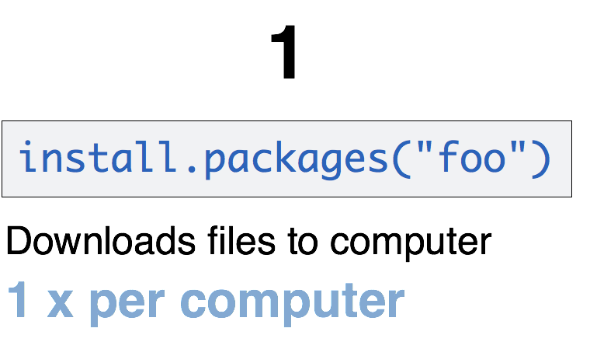
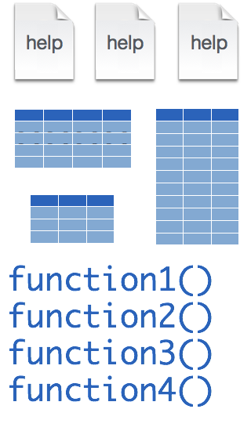
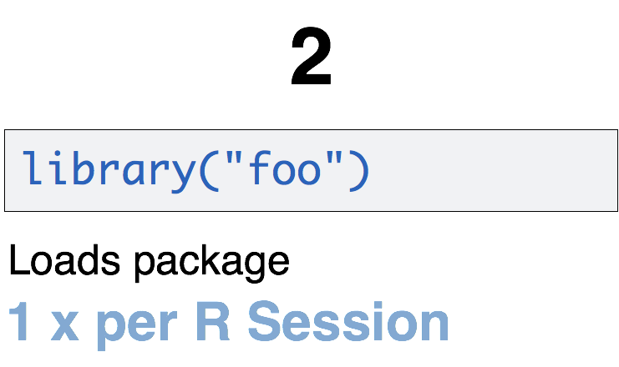
A Word About Packages
tidyverse
install.packages("tidyverse")
library("tidyverse")
CC BY-SA RStudio
Notes:
One of the features that makes R powerful is the fact that it’s easy to extend its functionality with packages.
A package is a essentially a zip file that contains data sets, functions, and help files that document those data sets and functions.
Packages need to be installed explicitly – with the command install.packages. So let’s say you want to install a package named “tidyverse”. You go to the R Console and type install.packages(“tidyverse”).
Each package you want to use needs to be installed only once on each computer. However, in order to use the functions or data in the package, you also need to load the package. This is done with the command “library”. So to enable all the functions in the “tidyverse” package, you type library(“tidyverse”). Packages remain loaded until you quit R. So every time you start a new R session you have to load each package that you want to use again.
On our RStudio Server, you won’t need to install any packages for this course. But at times you’ll need to load packages. We’ll practice this later.
So these are the first two R commands we’ve covered - install.packages and library.

Slide 24
R Markdown for Reproducible Reports
Code remains attached to its documentation and output
Text and code compile into a single HTML or PDF document that can be shared
Reproducible reports can be automated and turned into analytic dashboards
Notes:
R Markdown is a language for reproducible reporting. What this means is that:
You can have computer code right before or after a narrative that documents the purpose of the code and details about decisions that were made in the analysis.
R Markdown documents can be converted into web pages or PDF documents that can be shared.
Since R Markdown documents are computer code, it’s possible to automate them or turn them into analytic dashboards.

Slide 25
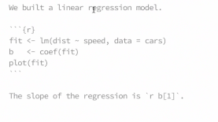
Better to show an example of an actual report, like this?
Notes:
An R Markdown document is a regular text file that has “marks” to add styling. This text document can then be converted into a HTML or PDF document, in a process called “knitting”.
The “marks” (#, *, brackets for link) are designed to be easy to read and remember.
**
Rmarkdown lets you add chunks of R code. This code - don't worry about how it works at this point - generates 100 normally distributed random numbers and assigns them to a variable called x. It then runs the summary function on x.
As you can see, in the rendered document the code chunk is placed neatly in a gray box to make it visually distinct from the marked up narrative text.
**
But here’s where it gets exciting: the rendered document also runs the code and shows the result right below the code! This way, a neatly formatted report is automatically the by-product of a completed analysis.
**
You can also include plots. Here we’re running the hist function on x, and the rendered document shows a histogram of the values in x.

Slide 26
Your Turn #2
Log onto the RStudio Server by pointing your browser to:
https://rstudio.uphs.upenn.edu:40400
Open 01-introduction.Rmd.
Read through the R Notebook and do everything it asks you to do.

Slide 27
Creating a New R Notebook

Slide 28
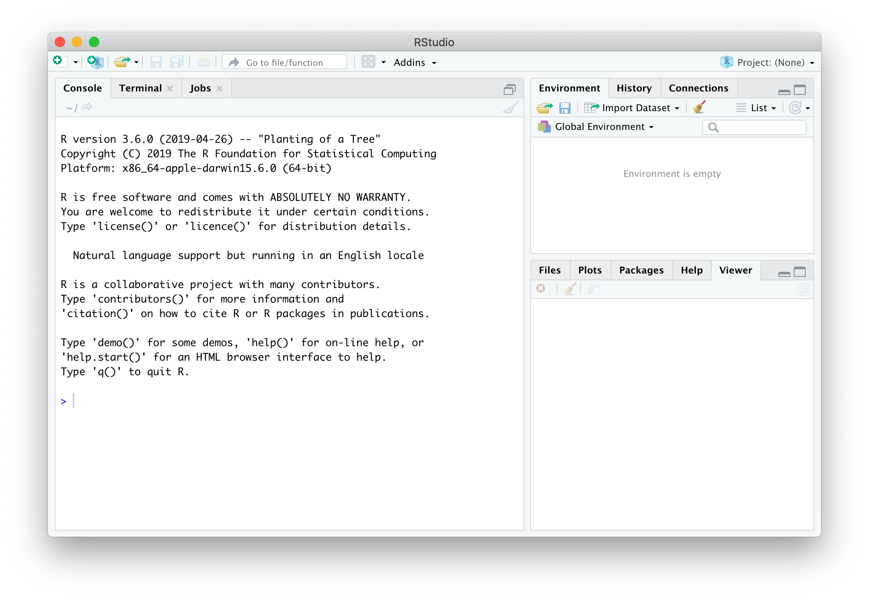
New Document
Notes:
Showing how this will look like when you have RStudio installed on your Desktop (which you will do later, and I want you to be able to go back to these notes) – but really similar on RStudio Server. Try to follow along.
Start by clicking + on upper left corner to create a new document.

Slide 29
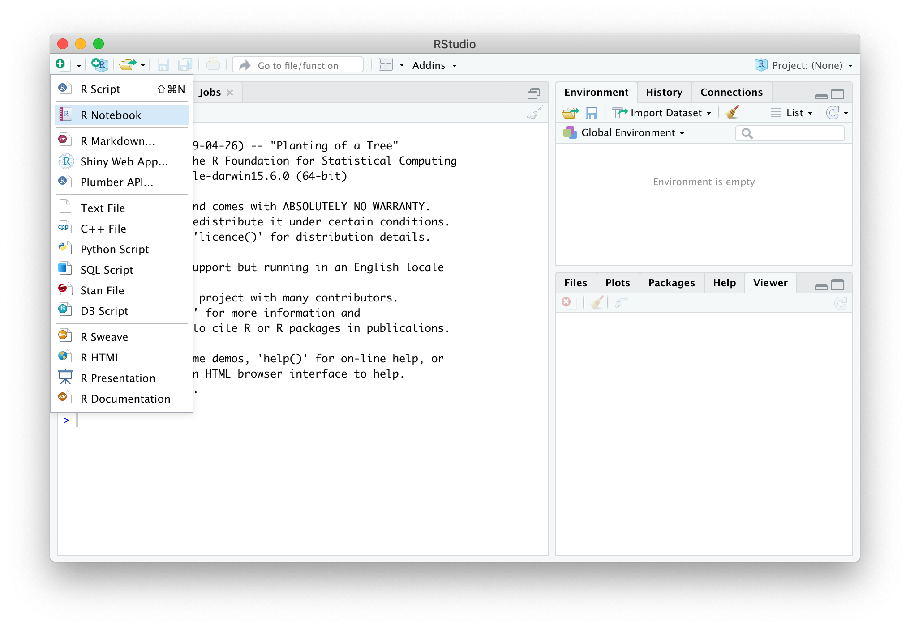
Select “R Notebook”
not “R Markdown”
Notes:
Select R Notebook – not R Markdown

Slide 30
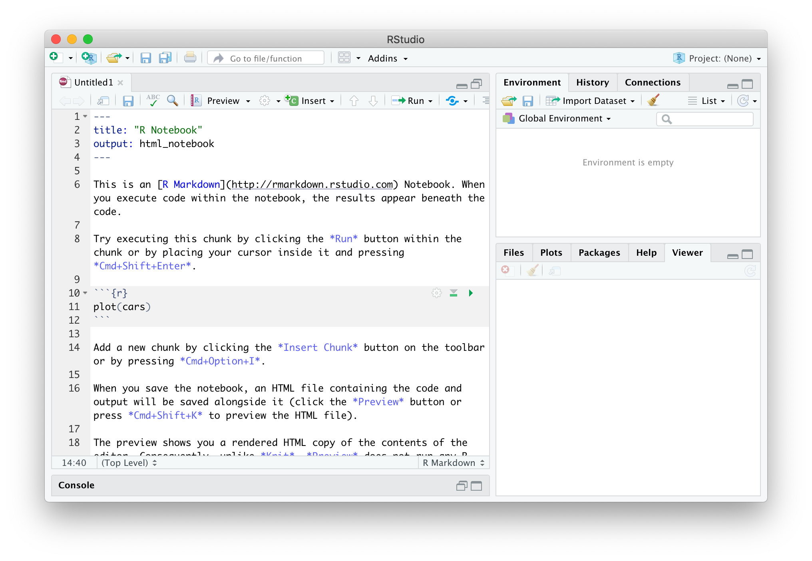
header
code chunk
Save Document
code chunk
Notes:
Opens editor, actually pre-filled with a some sample R Markdown code.
R Notebooks render by default to HTML. To see what the rendered HTML looks like, we first need to save the document.
You can name it “test” or keep as “Untitled”

Slide 31
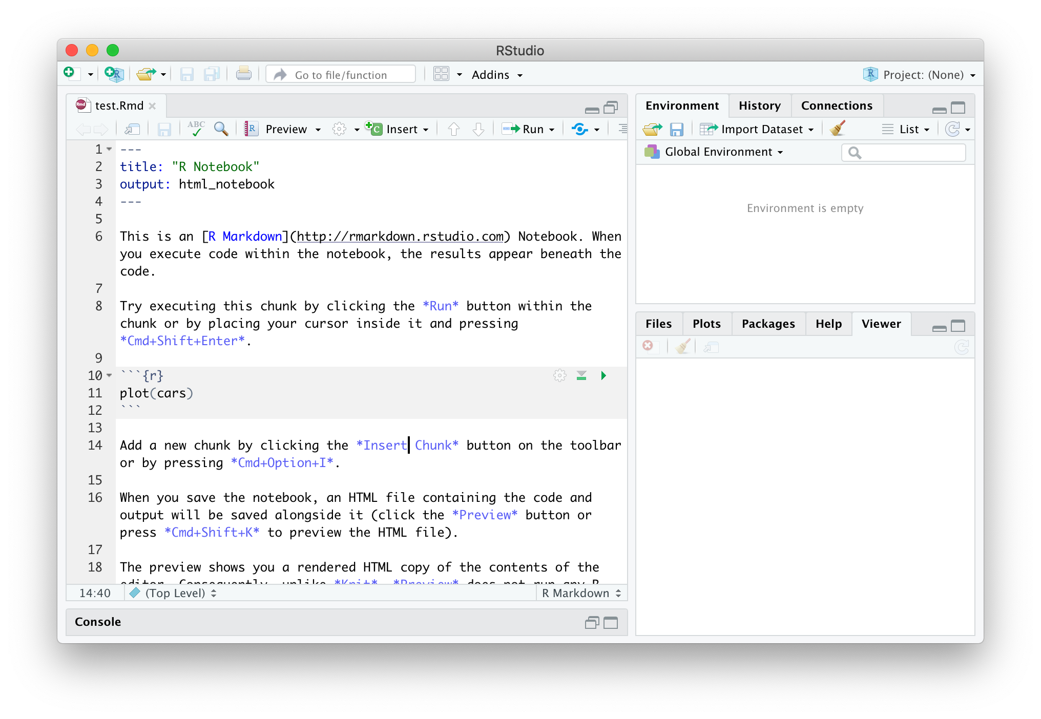
“Preview” Document
Notes:
Now click “Preview” to render the document to HTML.

Slide 32
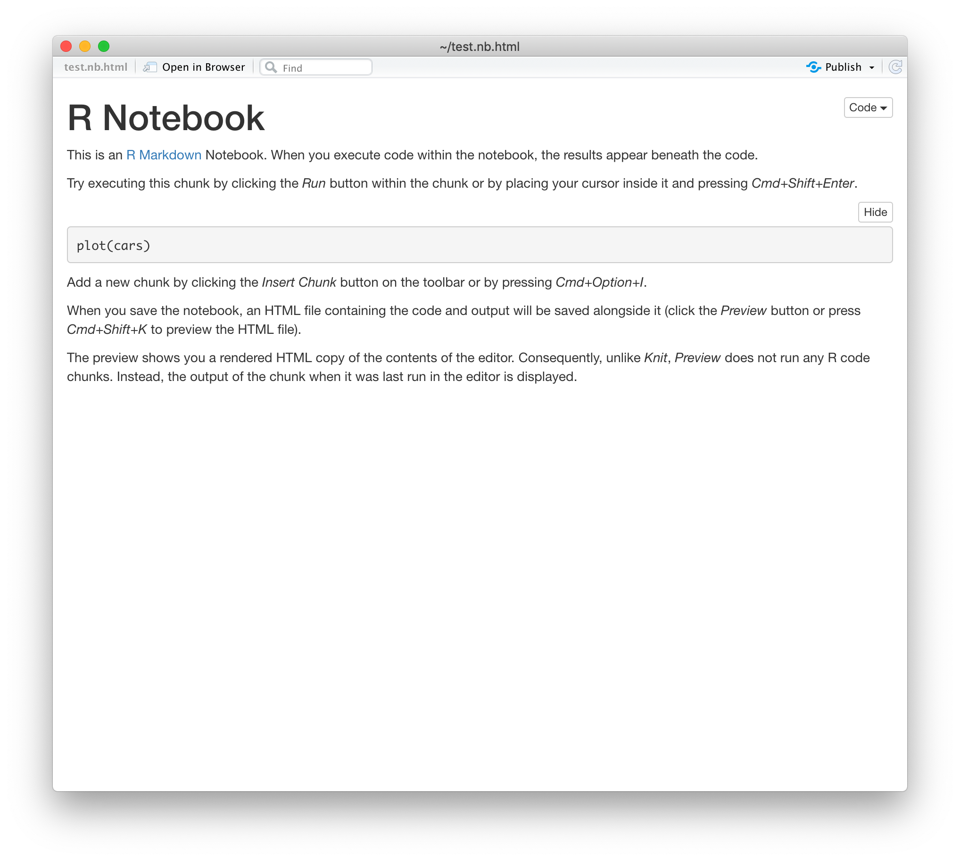
Notes:
A window should pop up showing the rendered document. However, the resulting plot is missing. That’s because in R Notebooks, running code is separate from rendering the document. That’s actually a good thing because it avoids re-running computationally expensive pieces of code unnecessarily and also allows you render documents even when your code is broken or incomplete.
So let’s go back to the editor.

Slide 33
Run Code Chunk
Notes:
To run the code chunk, click on the little green triangle.

Slide 34
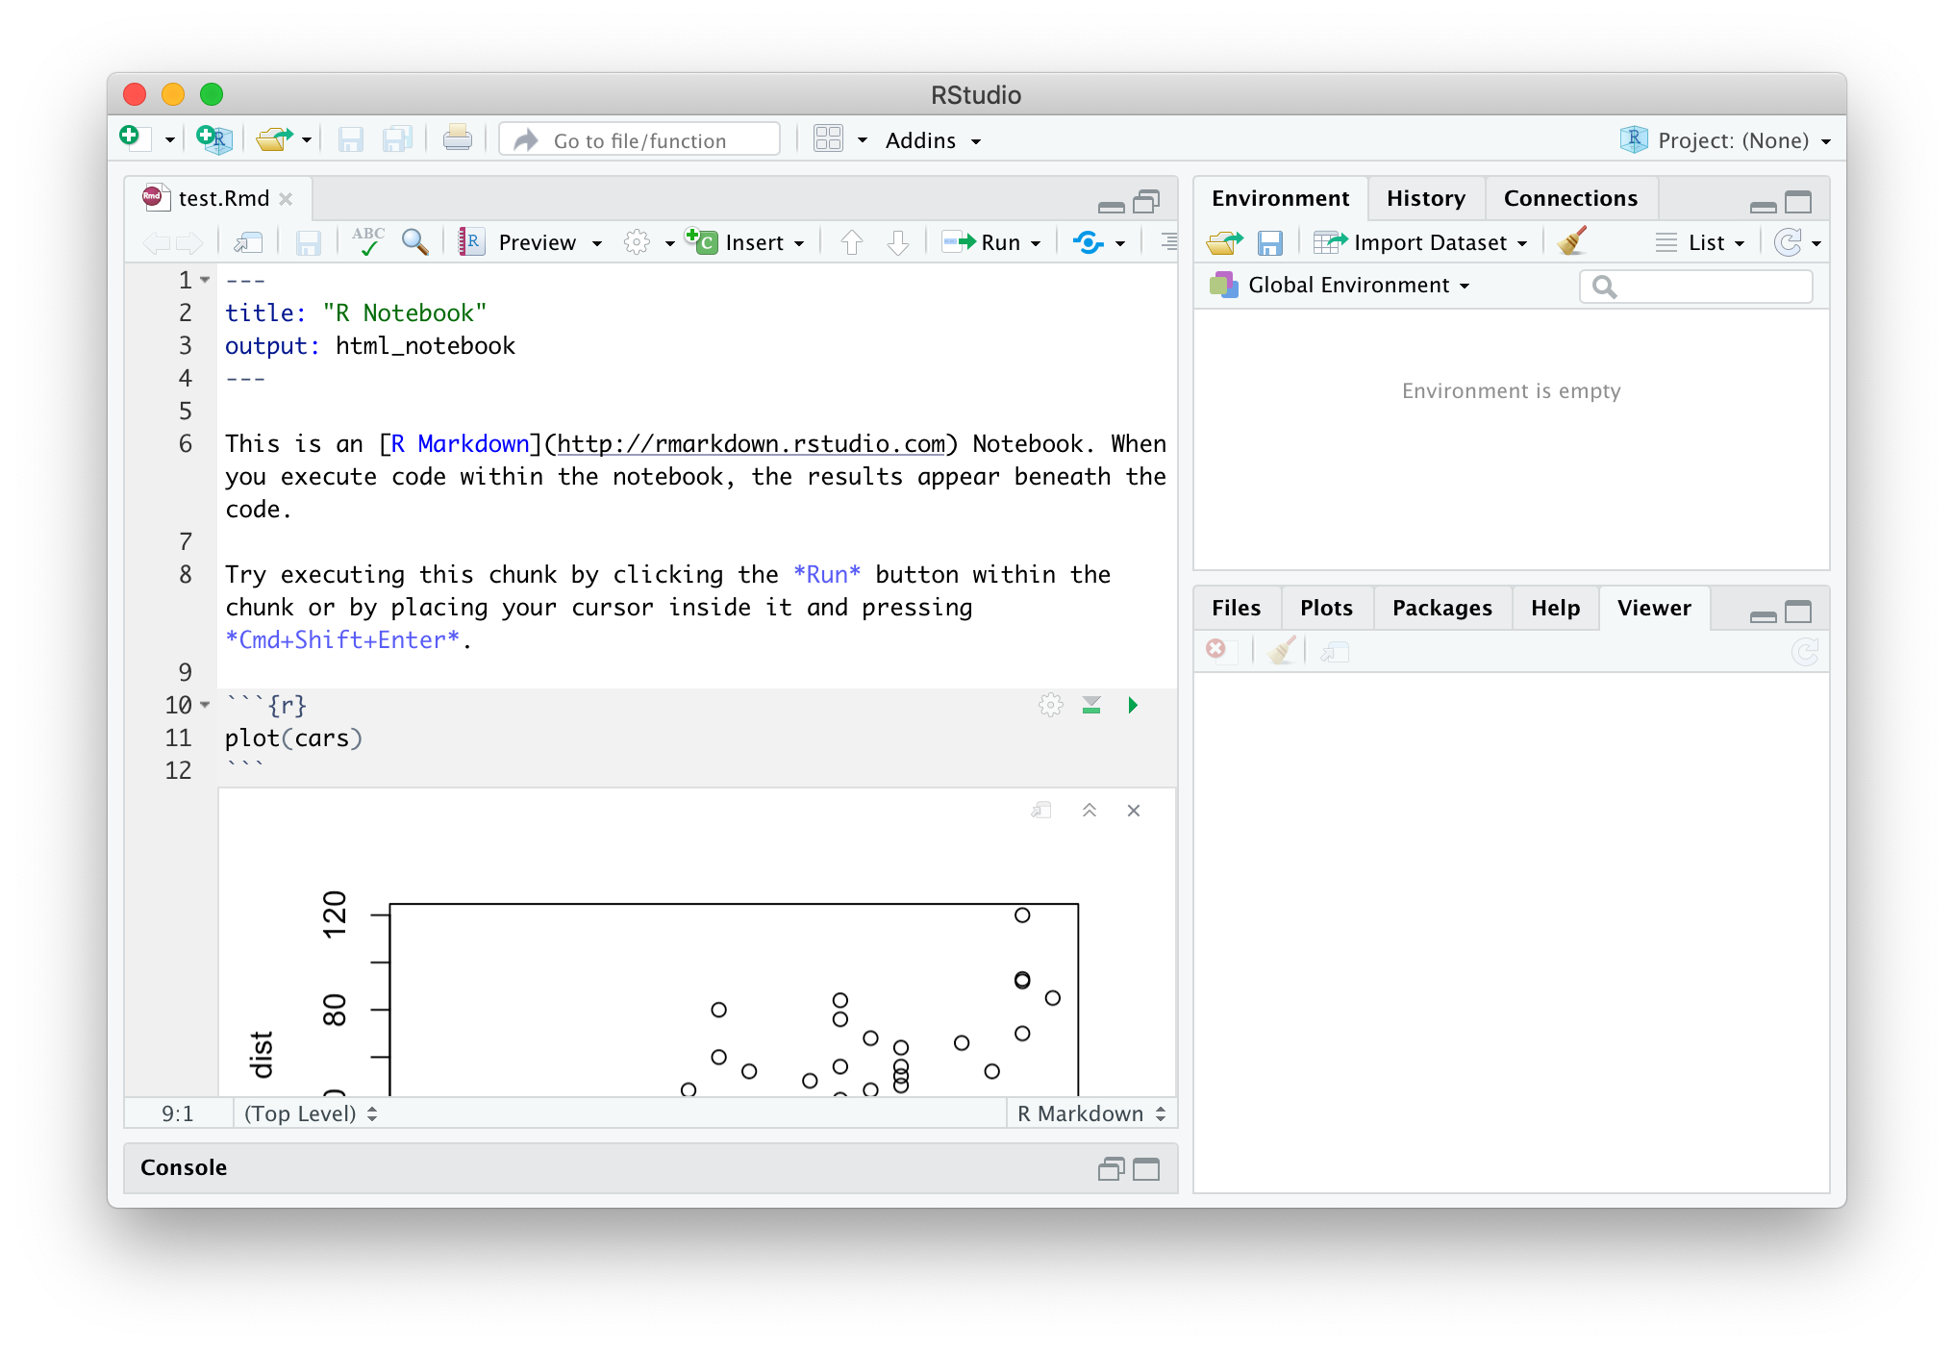
“Preview” Document
code chunk
result
Notes:
Now the resulting graphs pops up below the code chunk.
**

Slide 35
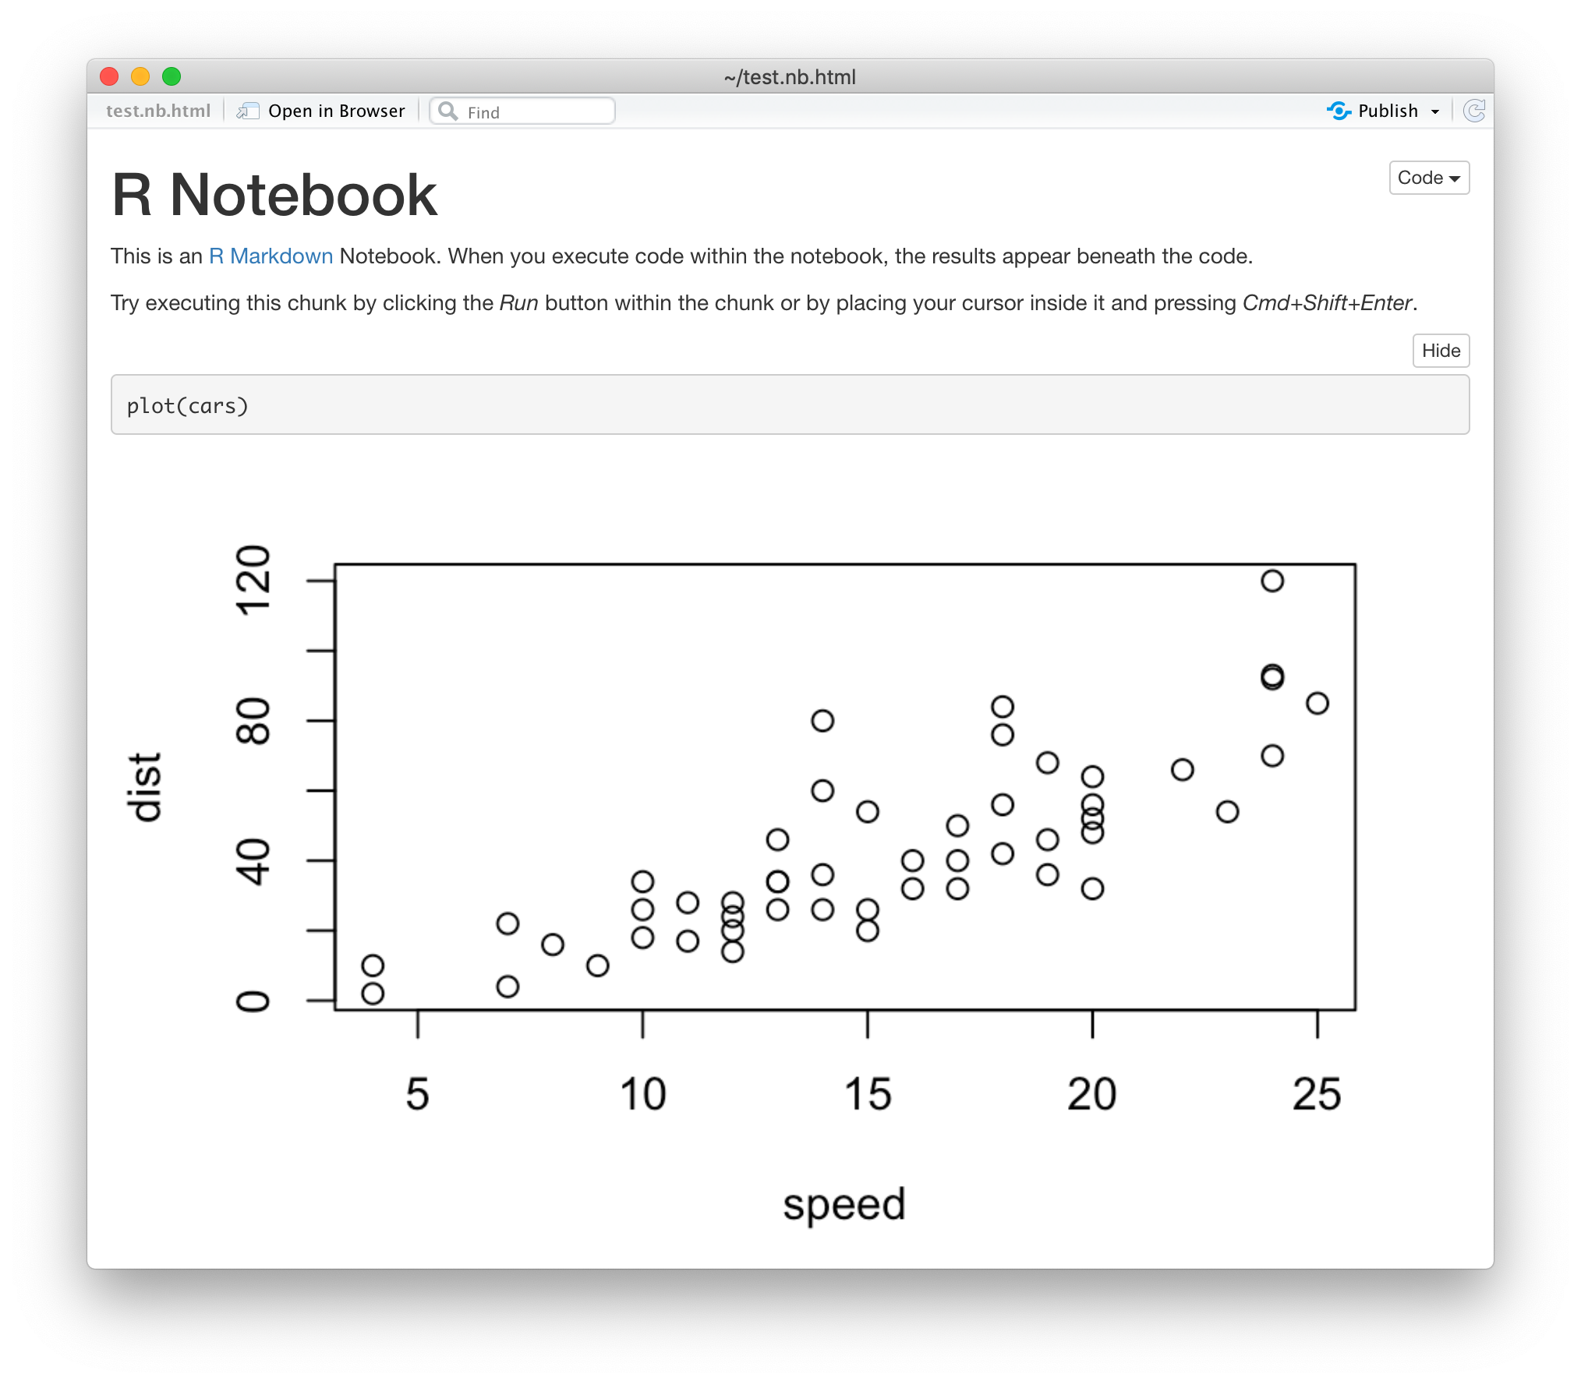
Notes:
When you press Preview again, the plot shows up!

Slide 36
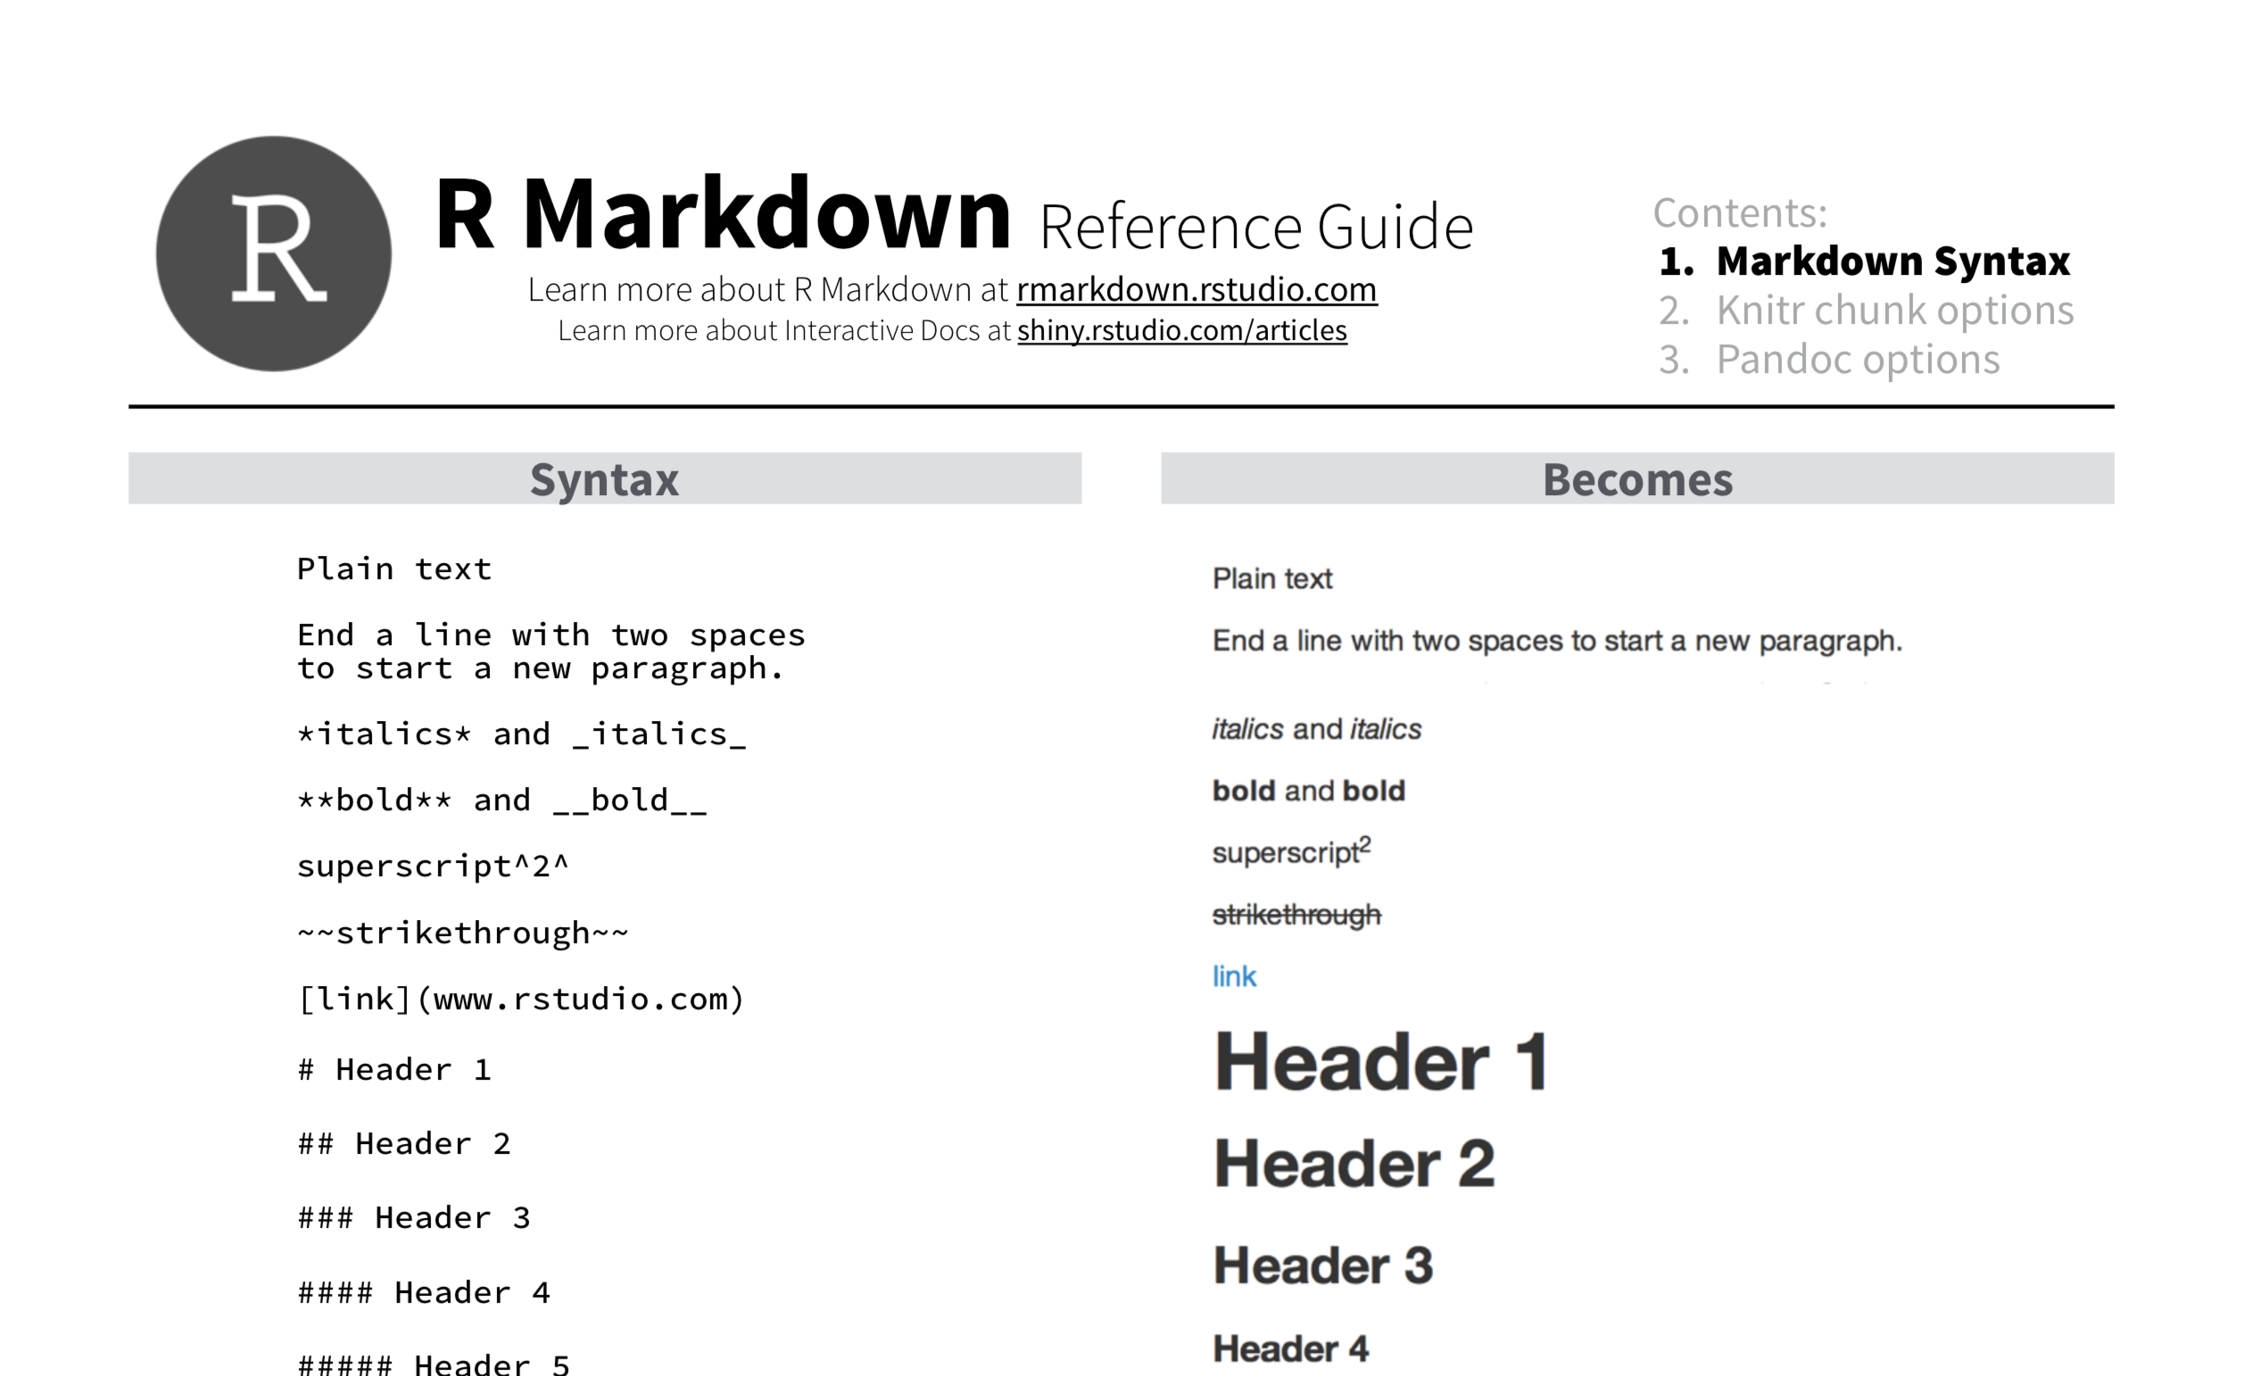
Notes:
We’ll be looking at a lot of R Markdown later, but for now, I want to point out this reference guide which is very handy for looking up how to write R Markdown. (I’ve printed out the first page which has the most useful information on it).

Slide 37
Your Turn #3
Create a new R Notebook. Save it as Practice.Rmd and preview it.
Now delete all the contents below the header and try to write the R Markdown that recapitulates the handout titled “R Notebook Practice”.

Slide 38
Notes for next time
Notes:
Camtasia shows two cursors, why?!
PennMedAccess link so users don’t need to use VPN

Slide 39
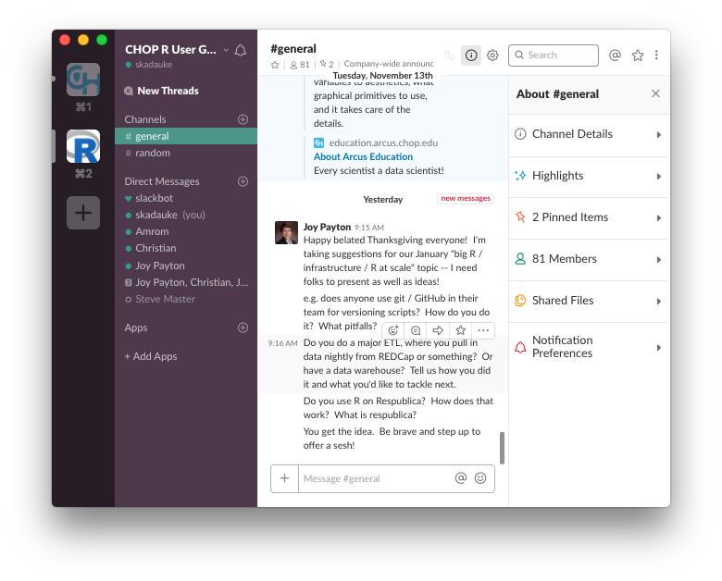
Notes:
I’m also one of the founders of the CHOP R Users group which aims among other things to bring together clinicians and analysts to more efficiently leverage the data within the CHOP enterprise. You guys are all totally welcome to join. We have educational meetings every two weeks that are also live-streamed so if you can’t make them you can watch along online. And we have a Slack community with more than members, and chances are if you’re stuck someone on there will be able to help you.

